Slide 1
Chapter -4
Deadlock
Prepared by: Marta G. (MSc)

Slide 2
The Deadlock Problem
A deadlock is a situation where a process or a set of processes is blocked, waiting for some resource that is held by some other waiting process.
A set of blocked processes each holding a resource and waiting to acquire a resource held by another process in the set.
Example:- System has 2 tape drives.
P₁ and P₂ each hold one tape drive.
If each process now requests another drive, the two processes will be in a deadlocked state.

Slide 3
Bridge Crossing Example
Traffic only in one direction.
Each section of a bridge can be viewed as a resource.
If a deadlock occurs, it can be resolved if one car backs up (preempt resources and rollback).
Several cars may have to be backed up if a deadlock occurs.
Starvation is possible. why??

Slide 4
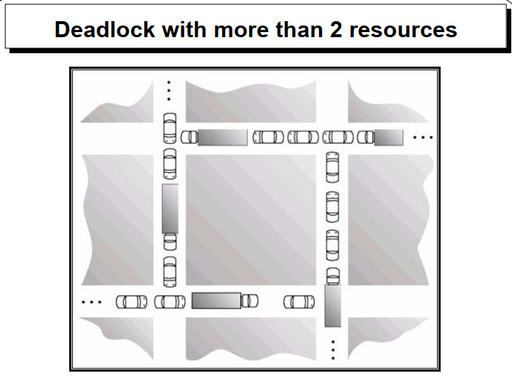

Slide 5
System Model
A set of blocked processes each holding a resource and waiting to acquire a resource held by another process in the set.
A system consists of a finite number of resources to be distributed among a number of competing processes.
Resource types R1, R2, . . ., Rm (like CPU cycles, memory space, printers or any other i/o devices, etc…)
The resources may be either physical (printers, tape drives, memory space, and CPU cycles) or logical (files and semaphores).Semaphore: is a variable or abstract data type that is used for controlling access by multiple processes to a common resource in a concurrent system such as a multiprogramming operating system.

Slide 6
Con’t…
A process must request a resource before using it, and must release the resource after using it.
A process may utilize a resource in only the following sequence:
1. Request: If the request cannot be granted immediately, then the requesting process must wait until it can acquire the resource.
2. Use: The process can operate on the resource (example, print on printer).
3. Release: The process releases the resource.

Slide 7
Con’t…
The request and release of resources are system calls (Examples: request and release device, open and close file, and allocate and free memory system calls).
Request and release of other resources can be accomplished through the wait and signal operations on semaphores.

Slide 8
Deadlock characterization
A deadlock situation can arise if the following four conditions hold simultaneously in a system:
Mutual execution
Hold and wait
No preemption
Circular wait

Slide 9
Cont…
Mutual exclusion- only one process at a time can use a resource. If another process requests that resource, the requesting process must be delayed until the resource has been released.
Hold and wait- A process must be simultaneously holding at least one resource and waiting for at least one resource that is currently being held by some other process.
No preemption- Resources cannot be preempted; that is a resource can be released only voluntarily by the process holding it, after that process has completed its task.
Circular Wait- There must be a circular chain of two or more processes, each of which is waiting for a resource held by the next member of the chain.

Slide 10
Resource-Allocation Graph
A deadlock is described in terms of a direct graph called a system RAG
A set of vertices V and a set of edges E.
V is partitioned into two types:
P = {P₁, P₂, …, P_{n}}, the set consisting of all the processes in the system.
R = {R₁, R₂, …, R_{m}}, the set consisting of all resource types in the system.
Request edge – directed edge Pi → R_{j}
Assignment edge – directed edge R_{j} → P_{i}

Slide 11
Con’t…
Process
Resource type with 4 instances
P_{i} requests instance of R_{j}
P_{i} is holding an instance of R_{j}
P_{i}
P_{i}

Slide 12
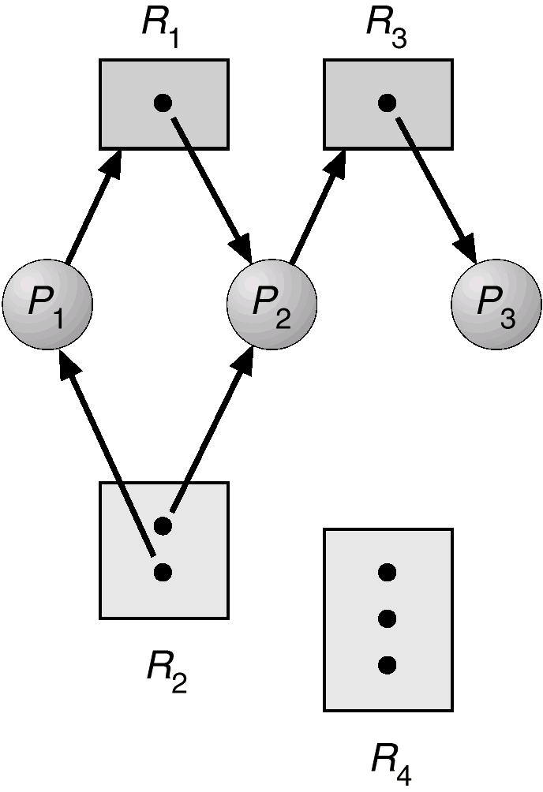
Example of a Resource Allocation Graph
Process State:
P1 is holding an instance of R2 and waiting for an instance of R1.
P2 is holding an instance of R1 and R2, and is waiting for an instance of R3.
P3 is holding an instance of R3.
• The graph does not contain any cycles.

Slide 13
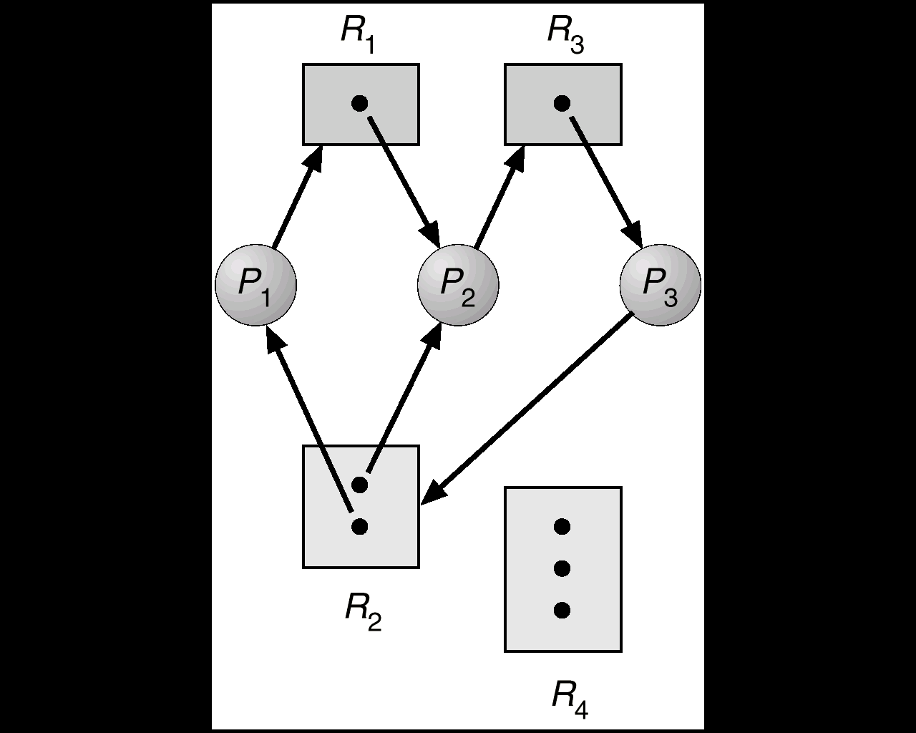
Resource Allocation Graph With A Deadlock
• Two minimal cycles exist in the system:
P1→R1→P2→R3→ P3→ R2→P1
P2→R3→P3→R2→P2
• Processes P1, P2, P3 are deadlocked.
P1 is waiting for P2 to release R1.
P2 is waiting for R3 which is held by P3.
P3 is waiting for P1 or P2 to release R2.

Slide 14
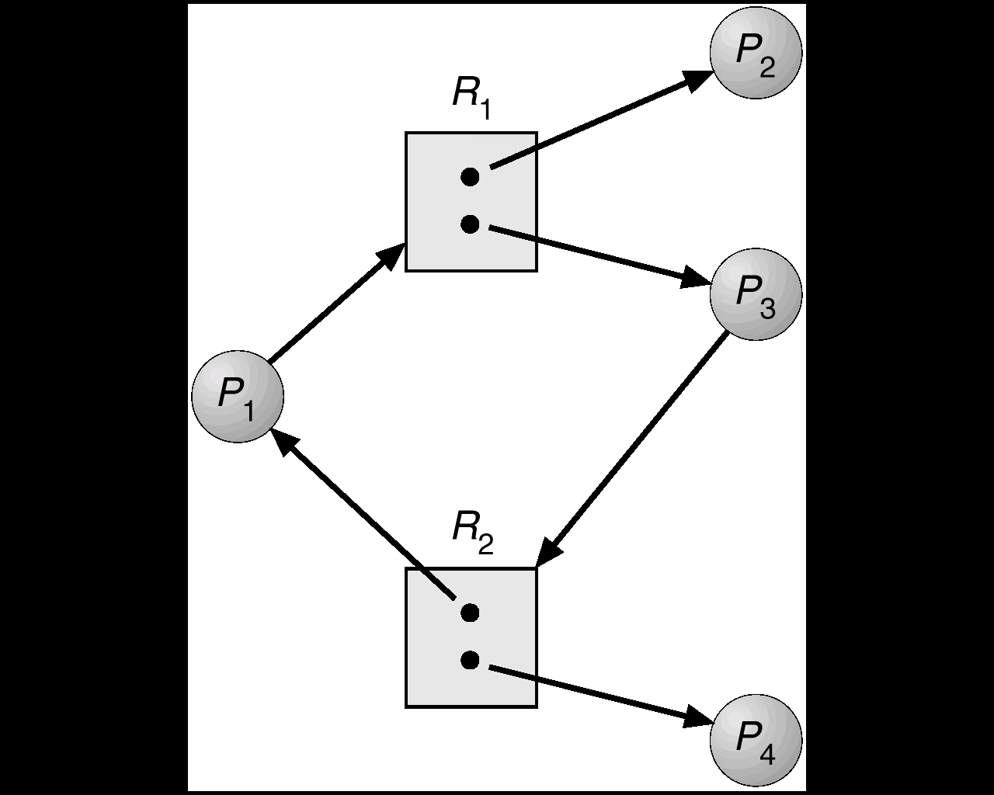
Resource Allocation Graph With A Cycle
We have a cycle: P1→R1→P3→R2→P1
P4 may release its instance of R2 and that resource can then be allocated to P3 breaking the cycle.

Slide 15
There is no deadlock on the above RAG.

Slide 16
Basic Facts
If a resource-allocation graph does contain cycles AND each resource category contains only a single instance, then a deadlock exists.
If a resource category contains more than one instance, then the presence of a cycle in the resource-allocation graph indicates the possibility of a deadlock, but does not guarantee one.

Slide 17
Methods for Handling Deadlocks
Generally speaking we can deal with the deadlock problem in one of four ways:
Just ignore the problem. Maybe if you ignore it, it will ignore you.
Prevention, by structurally negating*one of the four required conditions.
Dynamic avoidance by careful resource allocation.
Detection and recovery. Let deadlocks occur, detect them, and take action.

Slide 18
4.4.1. Deadlock Prevention
Prevent any one of the four (4) conditions from happening.
By ensuring that at least one of these conditions cannot hold, we can prevent the occurrence of a deadlock.
Do not allow one of the four conditions to occur.

Slide 19
1. Mutual Exclusion
Not required for sharable resources must hold for non-sharable resources.
Mutual section from the resource point of view is the fact that a resource can never be used by more than one process simultaneously which is fair enough but that is the main reason behind the deadlock.
If a resource could have been used by more than one process at the same time then the process would have never been waiting for any resource.
However, if we can be able to violate resources behaving in the mutually exclusive manner then the deadlock can be prevented.

Slide 20
Cont…
Spooling
For a device like printer, spooling can work.
There is a memory associated with the printer which stores jobs from each of the process into it.
Later, Printer collects all the jobs and print each one of them according to FCFS.
By using this mechanism, the process doesn't have to wait for the printer and it can continue whatever it was doing.
Later, it collects the output when it is produced.

Slide 21
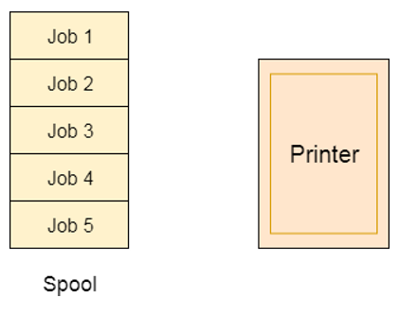
Cont…

Slide 22
Cont…
Spooling suffers from two kinds of problems.
This cannot be applied to every resource.
After some point of time, there may arise a race condition between the processes to get space in that spool.

Slide 23
2. Hold and Wait: Collect all resources before execution.
Hold and wait condition lies when a process holds a resource and waiting for some other resource to complete its task.
Deadlock occurs because there can be more than one process which are holding one resource and waiting for other in the cyclic order.
To prevent deadlock, a process must be assigned all the necessary resources before the execution starts. A process must not wait for any resource once the execution has been started.
!(Hold and wait) = !hold or !wait (negation of hold and wait is, either you don't hold or you don't wait)

Slide 24
Cont…
This can be implemented practically if a process declares all the resources initially.
This can't be done in the computer system because a process can't determine necessary resources initially.
Protocol 1: request all tape, disk, printer and hold for entire execution; note printer will be idle for a long time.

Slide 25
Cont…
The problem with the approach is:
Practically not possible.
Low resource utilization
Possibility of getting starved will be increases due to the fact that some process may hold a resource for a very long time.

Slide 26
3. No preemption
Release any resource already being held if the process can‘t get an additional resource.
Deadlock arises due to the fact that a process can't be stopped once it starts.
However, if we take the resource away from the process which is causing deadlock then we can prevent deadlock.

Slide 27
Cont…
If a process that is holding some resources requests another resource that cannot be immediately allocated to it, then all resources currently being held are released.
Preempted resources are added to the list of resources for which the process is waiting.
Process will be restarted only when it can regain its old resources, as well as the new ones that it is requesting.

Slide 28
Cont…
This is not a good approach at all since if we take a resource away which is being used by the process then all the work which it has done till now can become inconsistent.
Consider a printer is being used by any process. If we take the printer away from that process and assign it to some other process then all the data which has been printed can become inconsistent and ineffective and also the fact that the process can't start printing again from where it has left which causes performance inefficiency.

Slide 29
Con’t…
4. Circular Wait: Number of resources and only request in ascending order.
To violate circular wait, we can assign a priority number to each of the resource. A process can't request for a lesser priority resource.
This ensures that not a single process can request a resource which is being utilized by some other process and no cycle will be formed.
To ensure that the circular-wait condition never holds is to determine a total ordering of all resource types, and to require that each process requests resources in an increasing order of enumeration.
Impose a total ordering of all resource types, and require that each process requests resources in an increasing order of enumeration.

Slide 30
Con’t…
Example: Let R={R1, R2, …, Rm} be the set of resource types.
Assign to each resource type a unique integer number to compare two resources and to determine whether one proceeds another in ordering.
For example: If the set of resource types R includes tape drives, disk drives, and printers, then a function F might be defined as follows:
F(tape drive)= 1; F(disk drive)= 5; F(Printer)= 12.
A protocol to prevent deadlocks: Each process can request resources only in an increasing order of enumeration.

Slide 31
Con’t…
That is, a process can initially request any number of instances of a resource type say, Ri. After that the process can request instances of resource type Rj if and only if F(Rj) > F(Ri).
For example: using the function defined previously, a process that wants to use the tape drive and printer at the same time must first request the tape drive and then request the printer.
Alternatively, we can require that a process requesting an instance of resource type Rj, must have released any resources Ri such that F(Ri) ≥ F(Rj). Note also that if several instances of the same resource type are needed, a single request for all of them must be issued.

Slide 32
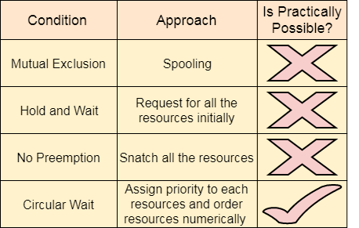
Is practically possible?
Among all the methods, violating Circular wait is the only approach that can be implemented practically.

Slide 33
4.4.2. Deadlock Avoidance
It is to prevent deadlocks from ever happening, by preventing at least one of the aforementioned conditions.
Requires that the system has some additional a priori information about how resources are to be requested.
Simplest and most useful model requires that each process declare the maximum number of resources of each type that it may need.
The deadlock-avoidance algorithm dynamically examines the resource-allocation state to ensure that there can never be a circular-wait condition.
Resource-allocation state is defined by the number of available and allocated resources, and the maximum demands of the processes.

Slide 34
deadlock avoidance Cont…
Requires the system to have additional prior information about the use of resources by processes.
Each process declares the maximum number of resources =>
Resource allocation state [no. of available, allocated and maximum demand of process] => safe state(the system find out whether the system is in a safe state or not)
If there exist a safe sequence(sequence or order in which processes can be finished successfully) of all processes
This sequence may be changed

Slide 35
Cont…
The main difference between deadlock prevention and deadlock avoidance is that the deadlock prevention ensures that at least one of the necessary conditions to cause a deadlock will never occur, while deadlock avoidance ensures that the system will not enter an unsafe state.

Slide 36
Safe State
When a process requests an available resource, system must decide if immediate allocation leaves the system in a safe state.
A state is safe if the system can allocate all resources requested by all processes ( up to their stated maximums ) without entering a deadlock state.

Slide 37
Cont…
More formally, a state is safe if there exists a safe sequence of processes { P0, P1, P2, ..., PN }
Sequence of all processes <P₁, P₂, …, P_{n}> is safe if for each P_{i}, the resources that Pi can still request can be satisfied by currently available resources + resources held by all the P_{j}, with j<I.
If P_{i} resource needs are not immediately available, then P_{i} can wait until all P_{j} have finished.
When P_{j} is finished, P_{i} can obtain needed resources, execute, return allocated resources, and terminate.
When P_{i} terminates, P_{i+1} can obtain its needed resources, and so on.

Slide 38
Cont…
If a safe sequence does not exist, then the system is in an unsafe state, which MAY lead to deadlock. ( All safe states are deadlock free, but not all unsafe states lead to deadlocks. )

Slide 39
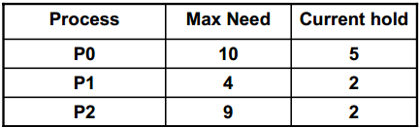
Example one
Consider a system with 12 tape drives and 3 processes, allocated as follows in a table at state T0.
Q: Is this a safe state? What is the safe sequence?
Available resource=total resource- allocated resource
Available resource= 12-9= 3

Slide 40
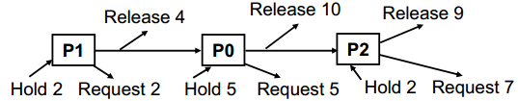
Cont…
First we have to find out the safe sequence
So that, we can fulfill the request of P1, P0 and P2 respectively.
<P1, P0, P2> satisfies the safety condition.
Or
Yes, it is a safe state and the save sequence is <P1,P0,P2>

Slide 41
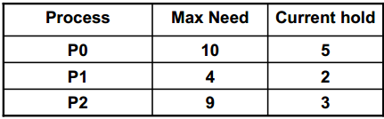
Example two
Q1: Is the following system safe?
A system with 12 tape drives and 3 processes: P0, P1, P2 at state T0.

Slide 42
Cont…
Available resource=total resource- allocated resource
Available resource= 12-10= 2
This sequence <P1, P0, P2> is unsafe; only P1 can be satisfied. P0 and P2 must waits yielding to a deadlock.

Slide 43
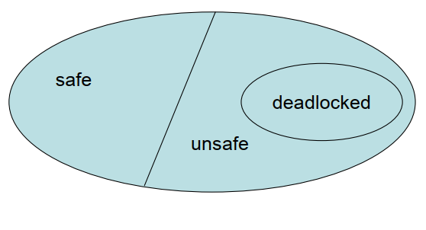
Basic Facts
If a system is in safe state ⇒ no deadlocks.
If a system is in unsafe state ⇒ possibility of deadlock.
Avoidance ⇒ ensure that a system will never enter in an unsafe state.
Safe, unsafe , deadlock state spaces.

Slide 44
Avoidance algorithms
Single instance of a resource type
Use a resource-allocation graph
Multiple instances of a resource type
Use the banker’s algorithm

Slide 45
1. Resource-Allocation Graph Algorithm
In addition to the request and assignment edges already described, we introduce a new type of edge, called a claim edge.
Claim edge Pi ----->Rj indicated that process Pi may request resource Rj for future (represented by a dashed line)
Claim edge converts to request edge when a process requests a resource.
Request edge converted to an assignment edge when the resource is allocated to the process
When a resource is released by a process, assignment edge reconverts to a claim edge.

Slide 46
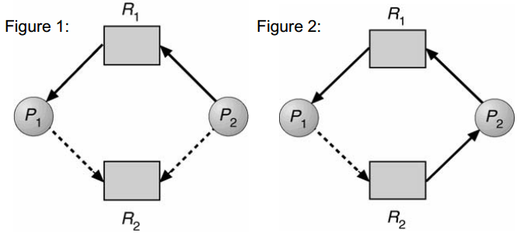
Resource-Allocation Graph For Deadlock Avoidance
Figure 2 shows an unsafe state in a resource-allocation graph, because there is a cycle in the graph.
The resource-allocation graph algorithm is not applicable to a resource allocation system with multiple instances of each resource type.

Slide 47
2. Banker’s Algorithm
Banker’s algorithm is applicable to a resource-allocation system with multiple instances of each type.
From it’s name, it could be used in a banking system to ensure that the bank never allocates its available cash such that it can no longer satisfy the needs of all customers.(banks never run out of the resources or money and always been in a safe state).
When a process requests a resource it may have to wait.
When a process gets all its resources it must return them in a finite amount of time.

Slide 48
Data Structures for the Banker’s Algorithm
Let “n” be the number of processes and “m” be the number of resources types. So we needs the following DS to implement Bankers algorithm.
Available: Vector of length “m” indicates the number of available resources of each type.
If available [j] = k, there are k instances of resource type R_{j} available.
Max: An (n*m) matrix defines the maximum demands of each process.
If Max [i,j] = k, then process P_{i} may request at most k instances of resource type R_{j}.

Slide 49
Con’t….
Allocation: An (n*m) matrix defines the number of resources of each type currently allocated to each process.
If Allocation [i,j] = k then P_{i} is currently allocated k instances of R_{j.}
Need: An (n*m) matrix indicates the remaining resource need of each process.
If Need [i,j] = k, then P_{i} may need k more instances of R_{j} to complete its task. Need [i,j] = Max[i,j] – Allocation [i,j].

Slide 50
Safety Algorithm
Step-1: Let Work and Finish be vectors of length m and n, respectively.
Initialize: Work = Available and
Finish [i] = false, for i = 0,1, …,n-1.
Step-2: Find an i such that both:
(a) Finish [i] = false
(b) Need i ≤ Work
If no such i (no process) exists, go to step 4.
Step-3: Work = Work + Allocation i
Finish[i] =true
go to step 2.
Step-4: If Finish [i] = true for all i, then the system is in a safe state

Slide 51
Resource-Request Algorithm for Process P_{i}
Request = request vector for process P_{i}.If Request_{i} [j]= k then process P_{i} wants k instances of resource type R_{j.}
Step-1: If Request_{i} ≤ Need_{i,} go to step 2. Otherwise, raise error condition, since process has exceeded its maximum claim.
Step-2: If Request_{i} ≤ Available, go to step 3. Otherwise P_{i} must wait, since resources are not available.
Step-3: Pretend to allocate requested resources to P_{i} by modifying the state as follows:
Available = Available - Request_{i};
Allocation_{i} = Allocation_{i} + Request_{i};
Need_{i} = Need_{i} – Request_{i;}
If safe ⇒ the resources are allocated to P_{i}.
If unsafe ⇒ P_{i} must wait, and the old resource-allocation state is restored

Slide 52
Example of Banker’s Algorithm
5 processes P₀ through P₄; 3 resource types A (10 instances), B (5 instances, and C (7 instances).
Snapshot at time T₀: we have the following resource allocation state.
Allocation Max Available
A B C A B C A B C
P₀ 0 1 0 7 5 3 3 3 2
P₁ 2 0 0 3 2 2
P₂ 3 0 2 9 0 2
P₃ 2 1 1 2 2 2
P₄ 0 0 2 4 3 3

Slide 53
Cont…
Q1: what is the need matrix?
Q2: Is the system in safe state?
Q3: If yes, find the safe sequence.

Slide 54
Answer
Total resource= Total allocation + Available resource
Need is defined to be Max – Allocation
(Need [n][m]= Max [n][m] – Allocation[n][m])
Allocation Max. R.N Available Need
A B C A B C A B C A B C
P₀ 0 1 0 7 5 3 3 3 2 7 4 3
P₁ 2 0 0 3 2 2 5 3 2 1 2 2
P₂ 3 0 2 9 0 2 7 4 3 6 0 0
P₃ 2 1 1 2 2 2 7 4 5 0 1 1
P₄ 0 0 2 4 3 3 7 5 5 4 3 1
Safe sequence: <P1, P3 , P4 , P2, P0>
Yes, the system is in a safe state

Slide 55
In bankers algorithm inputs are:
Processes
Any 2 out of 3(Max, Need, Allocation)
Available or Total no. of resources

Slide 56
Exercise 1:
Q: The following table is given:
Allocation Max Available
A B C D A B C D A B C D
P₀ 0 0 1 2 0 0 1 2 1 5 2 0
P₁ 1 0 0 0 1 7 5 0
P₂ 1 3 5 4 2 3 5 6
P₃ 0 6 3 2 0 6 5 2
P₄ 0 0 1 4 0 6 5 6
Q1: Find the total number of resources?
Q2: what is the need matrix?
Q3: Is the system in safe state?
Q4: If yes, find the safe sequence?

Slide 57
Answer
Allocation Max Available Need
A B C D A B C D A B C D A B C D
P₀ 0 0 1 2 0 0 1 2 1 5 2 0 0 0 0 0
P₁ 1 0 0 0 1 7 5 0 1 5 3 2 0 7 5 0
P₂ 1 3 5 4 2 3 5 6 2 8 8 6 1 0 0 2
P₃ 0 6 3 2 0 6 5 2 2 14 11 8 0 0 2 0
P₄ 0 0 1 4 0 6 5 6 2 14 12 12 0 6 4 2
Total no of resource: 3 14 12 12
System is in a Safe state
Safe sequence is: <P0, P2, P3, P4,P1>

Slide 58
Example P₁ Request (1,0,2) Con’t.
Check that Request ≤ Available (that is, (1,0,2) ≤ (3,3,2) ⇒ true.
Allocation Max Available Need Available after relase
A B C A B C A B C A B C A B C
P₀ 0 1 0 7 5 3 2 3 0 7 4 3 7 5 5
P₁ 3 0 2 3 2 2 0 2 0 5 3 2
P₂ 3 0 2 9 0 2 6 0 0 10 5 7
P₃ 2 1 1 2 2 2 0 1 1 7 4 3
P₄ 0 0 2 4 3 3 4 3 1 7 4 5
Executing safety algorithm shows that sequence <P₁, P₃, P₄, P₀, P₂> satisfies safety requirement.
Can request for (3,3,0) by P₄ be granted?
Can request for (0,2,0) by P₀ be granted?

Slide 59
Deadlock Detection
If a system does not employ a deadlock prevention algorithm or a deadlock avoidance algorithm, then a deadlock situation may occur.
• Therefore, the system must provide:
– Detection: an algorithm that examines the state of the system to determine whether a deadlock has occurred.
– Recovery: an algorithm to recover from the deadlock.
A detection and recovery scheme requires overhead that includes: – Run-time costs of maintaining the necessary information. – Executing the detection algorithm. – The potential losses inherent in recovering from a deadlock.

Slide 60
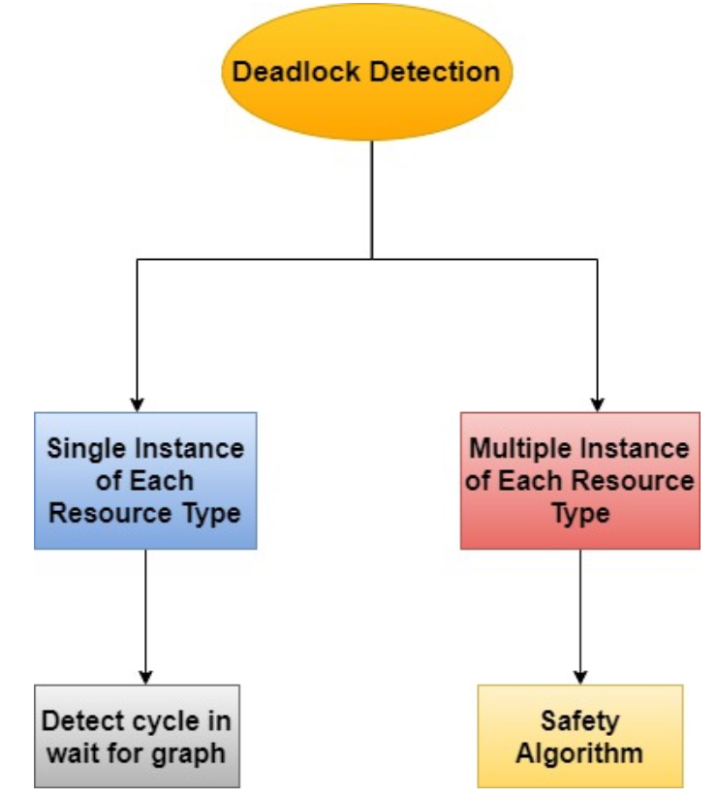

Slide 61
Single Instance of Each Resource Type
A deadlock detection algorithm uses a variant of the resource allocation graph called wait-for graph.
An edge from Pi to Pj in a wait-for graph implies that process Pi is waiting for process Pj to release a resource that Pi needs.
An edge Pi Pj exists in a wait-for graph if and only if the corresponding resource-allocation graph contains two edges Pi Rq and Rq Pj for some resource Rq.
A deadlock exists in the system if and only if the wait-for graph contains a cycle.

Slide 62
Con’t…
To detect deadlocks, the system needs to:- – Maintain the wait-for graph. – Periodically invoke an algorithm that searches for a cycle in the graph.
An algorithm to detect a cycle in a graph requires an order of n² operations, where n is the number of vertices in the graph.

Slide 63
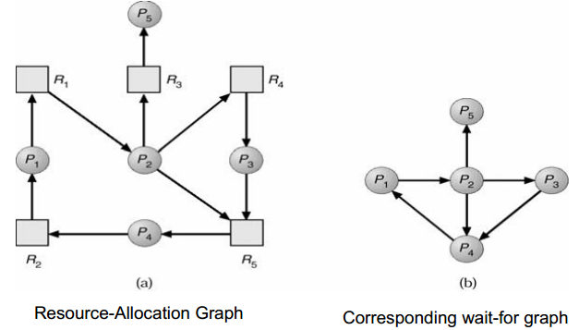
Resource-Allocation Graph and Wait-for Graph

Slide 64
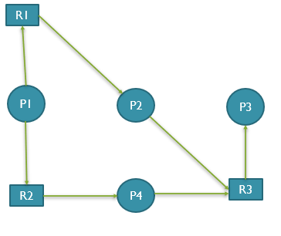
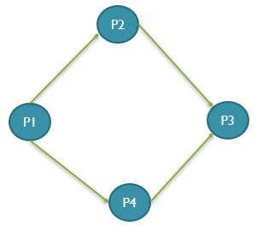
RAG Wait for graph
There is no cycle in this wait for graph so that there is no deadlock

Slide 65
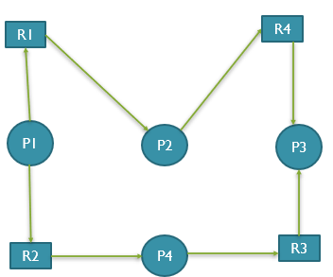
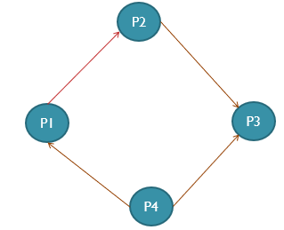
RAG wait for graph
There is a deadlock, so now deadlock detection mechanism called.
How frequently this deadlock detection algorithm would be called?
Whenever a deadlock happens, Deadlock detection algorithm will be invoked.

Slide 66
Cont…
The wait-for graph scheme is not applicable to a resource allocation system with multiple instances of each resource type.

Slide 67
Several Instances of a Resource Type
The algorithm employs several time-varying data structures that are similar to those used in the banker’s algorithm:
Note: “n” is number of processes in the system and “m” is the number of resource types.
Available: A vector of length “m” indicates the number of available resources of each type.
Allocation: An “n*m” matrix defines the number of resources of each type currently allocated to each process.
Request: An “n*m” matrix indicates the current request of each process. If Request [i,j] = k, then process Pi is requesting k more instances of resource type Rj.

Slide 68
Detection Algorithm
Step-1: Let Work and Finish be vectors of length m and n, respectively Initialize: Work = Available, For i = 1,2, …, n, if Allocation i ≠ 0, then ,Finish[i] = false; otherwise, Finish[i] = true.
Step-2: Find an index i such that both:
(a) Finish[i] = false
(b) Request_{i} ≤ Work If no such i exists, go to step 4.

Slide 69
Con't…
Step-3: Work = Work + Allocation_{i} Finish[i] = true go to step 2.
Step-4: If Finish[i] = false, for some i, 1 ≤ i ≤ n, then the system is in deadlock state. Moreover, if Finish[i] = false, then P_{i} is deadlocked.
Algorithm requires an order of m x n² operations to detect whether the system is in deadlocked state.

Slide 70
Example of Detection Algorithm
Five processes P₀ through P₄; three resource types A (7 instances), B (2 instances), and C (6 instances).
Snapshot at time T₀: we have the following resource allocation state:
Allocation Request Available
A B C A B C A B C
P₀ 0 1 0 0 0 0 0 0 0
P₁ 2 0 0 2 0 2
P₂ 3 0 3 0 0 0
P₃ 2 1 1 1 0 0
P₄ 0 0 2 0 0 2
Sequence <P₀, P₂, P₃, P₁, P₄> will result in Finish [i] = true for all i.

Slide 71
Con't…
P₂ requests an additional instance of type C.
Request
A B C
P₀ 0 0 0
P₁ 2 0 2
P₂ 0 0 1
P₃ 1 0 0
P₄ 0 0 2
State of system?
Can reclaim resources held by process P₀, but insufficient resources to fulfill other processes; requests.
Deadlock exists, consisting of processes P₁, P₂, P₃, and P₄.

Slide 72
Detection-Algorithm Usage
When should we invoke the detection algorithm? The answer depends on two factors:
1. How often is a deadlock likely to occur?
2. How many processes will be affected by deadlock when it happens?
If deadlocks occur frequently, then the detection algorithm should be invoked frequently.
Resources allocated to deadlocked processes will be idle until the deadlock can be broken.
In addition, the number of processes involved in the deadlock cycle may grow.
Deadlocks occur only when some process makes a request that cannot be granted immediately.

Slide 73
4.4.4. Recovery from Deadlock
When a detection algorithm determines that a deadlock exists, several alternatives are available.
One possibility is to inform the operator that a deadlock has occurred and to let the operator deal with the deadlock manually.
Another possibility is to let the system recover from the deadlock automatically.
There are two options for breaking a deadlock:
– To abort one or more processes to break the circular wait (Process Termination).
– To preempt some resources from one or more of deadlock processes (Resource Preemption).

Slide 74
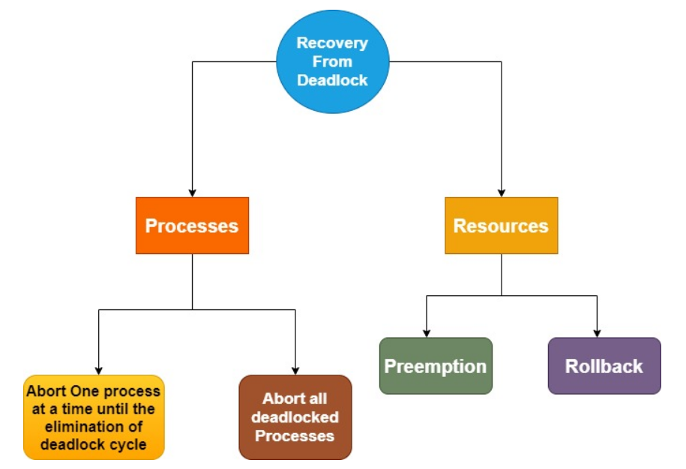

Slide 75
Recovery from Deadlock: Process Termination
Two methods to eliminate deadlocks by aborting a process. In both methods, the system reclaims all resources allocated to the terminated processes:
A. Abort all deadlocked processes: Clearly will break the deadlock cycle, but at great expense.
The deadlocked processes may have computed for a long time, and the results of these partial computations must be discarded and probably will have to be recomputed later.

Slide 76
B. Abort one process at a time until the deadlock cycle is eliminated:
This method incurs considerable overhead, since after each process is aborted, a deadlock-detection algorithm must be invoked to determine whether any processes are still deadlocked.
Aborting a process may not be easy. If the process was in the midst of updating a file, terminating it will leave that file in an incorrect state.

Slide 77
Con’t…
If the partial termination method is used, then we must determine which deadlocked process (or processes) should be terminated. This determination is a policy decision, similar to CPU-scheduling decisions.
The question is basically an economic one; we should abort those processes whose termination will incur the minimum cost.
Many factors may affect which process is chosen to abort?
1. What the priority of the process is?
2. How long the process has computed and how much longer the process will compute before completing its designated task?
3. How many and what types of resources the process has used (for example: whether the resources are simple to preempt)
4. How many more resources the process needs in order to complete?
5. How many processes will need to be terminated
6. Whether the process is interactive or batch

Slide 78
Recovery from Deadlock: Resource Preemption
If preemption is required to deal with deadlocks, then three issues need to be addressed:
Selecting a victim: which resources and which processes are to be preempted? (minimize cost)
Rollback: If we preempt a resource from a process, what should be done with that process? We must roll back the process to some safe state, and restart it from that state.
Starvation: Same process may always be picked as victim, include number of rollback in cost factor.

Slide 79
Combined Approach to Deadlock Handling
Combine the three basic approaches
– prevention
– avoidance
– detection
allowing the use of the optimal approach for each of resources in the system.
Partition resources into hierarchically ordered classes.
Use most appropriate technique for handling deadlocks within each class.

Slide 80
THANK YOU

